Slide 1
CENG 291 ENGINEERING IN SOCIETY

Slide 2
STRUCTURE OF PROJECT REPORT

Slide 3
Elements of Good Technical Communication
Clear
  Unambiguous
  Exact meaning conveyed
  Symbols fully defined
  Figures and tables easily understood

Slide 4
Elements of Good Technical Communication
Concise
  Omission of irrelevant data
  Try to answer the Who, What, Why, Where and the How
  Be careful not to oversimplify

Slide 5
Elements of Good Technical Communication
Appropriate writing Style
  Active vs. Passive Voice
  Use words to convey the appropriate meaning
  Avoid technical jargon
  Define jargon if necessary

Slide 6
Elements of Good Technical Communication
Guide your reader
  Tell readers what you plan to tell them (Introduction).
  Then tell them (main text).
  Finally tell them what you told them (Summary of Results or
  Conclusions).

Slide 7
Elements of Good Technical Communication
Guide your Reader
  State your purpose clearly
  Get to the point
  Emphasize major ideas

Slide 8
Elements of Good Technical Communication
Present the information from your work, both real world and theoretical, or your design/ drawings.
Organise information logically under appropriate headings.
Convey information in the most effective way for communication:
  use figures and tables
  You can use bulleted or numbered lists

Slide 9
Outline of Report
Facing/ Cover page
Acknowledgements
Abstract or Summary
Table of Contents

Slide 10
Parts of a Technical Report
Introduction
Materials and Methods
Results and Discussion
Conclusion and Recommendations
References
Appendix (es)

Slide 11
Facing Page
This page shows the student’s:
  University name
  College
  Department
  Title of Report
  Name
  Index Number
  Month and Year of Submission

Slide 12
Example of Title Page
  KWAME NKRUMAH UNIVERSITY OF SCIENCE AND TECHNOLOGY KUMASI, GHANA
  COLLEGE OF ENGINEERING
  DEPARTMENT OF AGRICULTURAL ENGINEERING
  CENG 291 ENGINEERING IN SOCIETY
  IMPROVEMENT OF IRRIGATION TECHNIQUES FOR FARMERS IN BANKYEKROM
  NAME: KWEKU ANANSE
  INDEX NO.: 0000000
  JANUARY 1777

Slide 13
Acknowledgement
  Acknowledge contributors and supporters of the project.
  Keep it not more than a paragraph.
  I would like to thank my supervisor, Mr. K. Ntikuma for the invaluable advice and support he gave me in carrying out this project and writing this report. I would also like to thank Mr. Q. R. S. T. Yuu, the chief engineer at …………………………….. …………………………

Slide 14
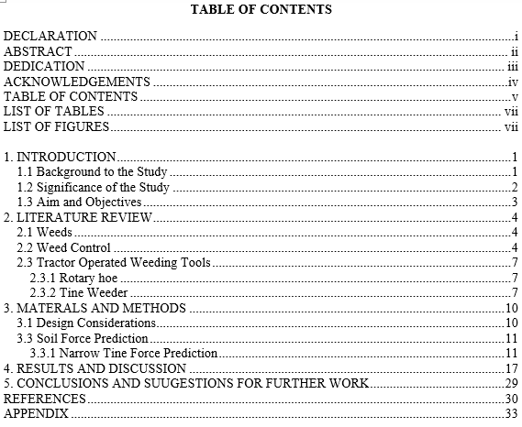

Slide 15
Abstract
It is a summary of the report.
It includes purpose, methods, results, conclusions, and recommendations
It highlights essential points of the report.
It follows strictly the chronology of the report
For this course, keep the abstract not more than half a page.
The abstract also adds no new information but simply summarizes the report

Slide 16
List of Tables and Figures
Figures include pictures, graphs and charts.
The list should include the table or figure number, the exact title and the page where it is found.
Tables and figures should stand on their own without reference to the text but they need to be referred to in the text.

Slide 17

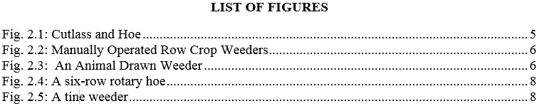
List of Tables and Figures

Slide 18
Introduction
Brief background to the Course and your specific project.
Objectives of the assignment under the heading Aim and Objectives
Do not show figures, tables and bulleted/ numbered points in the introduction

Slide 19
Materials and Methods
Describe how you identified the problem,
Describe how you prepared the map
Describe how you went about collecting the data
  State all the materials/ resources used in these processes.

Slide 20
Results and Discussion
Description of the community (your map should be placed here)
Description of the nature and characteristics of the problem
Description of your area of engineering and the different branches
Description of how the problem may be solved using knowledge from your programme of study

Slide 21
Tables and Figures
Give each figure and table a number and title.
Refer to each figure and table in the text of the report.
The title of a table goes above the table, while the title of a figure goes below the figure.

Slide 22
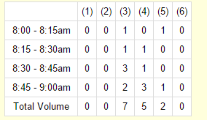
Tables and Figures:
Example
Table 1: Number of phones stolen from 8:00 to 9:00 am

Slide 23
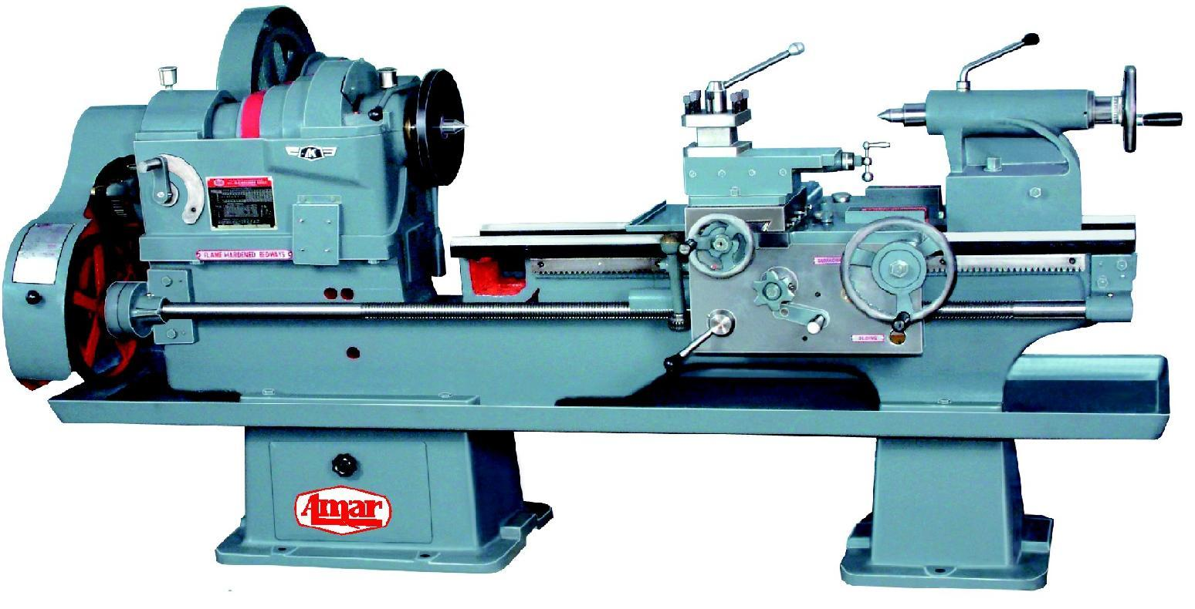
Tables and Figures
Figure 1: Centre lathe

Slide 24
Conclusion and Recommendations
Conclusion states the key findings from your study in a summary. It should address specifically, the objectives you set out to achieve.
Recommendations indicate what should be the follow up to your work to solve the problem?

Slide 25
Referencing
References serve as a guide to any reader who wants to refer to previous work on the subject.
It is also meant to show appreciation for the invaluable work of other researchers.
Failure to credit the work of others is regarded as:
  Carelessness on the part of the author
  Lack of courtesy and even more seriously
  Plagiarism, in which case the student would be failed

Slide 26
Referencing
A reference to some document in the write-up should simply have the surname of the author and the year of publication
If there are two authors, both names are given before the date
If there are more than two authors, the surname of the first author is given, followed by “et al” in italics and then the year
If one author has published more than one cited document in the same year, these are distinguished by adding lower case letters after the year.

Slide 27
Referencing
Referencing/ Citation in the text
“According to Agodzo (2003a) it is indicated …”
……………….. (Aikins, 2015)
“Equations developed by Bart-Plange et al (2002) can be used to …”
“Kyei-Baffour (2004) outlines the principle for the design of simulators…”

Slide 28
List of References
Journal: Bart-Plange, A. and Baryeh, E. A. (2003). The physical properties of Category B cocoa beans. Journal of Food Engineering. 20(1): 219-227
Book: Morgan, R. P. C. (1986). Soil erosion and conservation. Longman, U.K.
Contribution to a book: Kyei-Baffour, N., Bobobee, E. Y. H. and Koram, S. A. (1994). The effects of tillage and irrigation practices on soils in Ghana: A case study. In: L. O. Fresco, L. Stroosnijder, J. Bouma and H. van Keulen, eds. The future of the land. Willey, Sussex. 363-364
Technical Report: Agodzo, S. K., Huibers, F. P., Chenini, F., van Lier, J. B. and Duran, A. (2003). Use of wastewater in irrigated agriculture. Country studies from Bolivia, Ghana and Tunisia. Volume 2: Ghana. Wageningen WUR (WF4-Wastewater)-ISBN 90-6754-704-2

Slide 29
List of References
References
Agco Allis (2011 ). Tractor, Service and Operator’s Manuals. Electronic document. Retrieved from: http://www.tractormanual.info/. Accessed 3 May 2011.
Bhutta, M.S., Tanveer, T. & Awan, H.M. (1997). Technical Skill of Tractor Operator: A Case Study in Multan, Pakistan. Agricultural
Mechanisation in Asia, Africa and Latin America, 28 (1): pp. 18–22.
Davies, D.B., Eagle, D.J. & Finney, J.B. (1993). Soil Management, Ipswich, Farming Press.
MINITAB Inc. (2007). MINITAB Statistical Software Release 15 for Windows. Pennsylvania, Minitab Inc., State College.

Slide 30
Appendices
Copies of your questionnaire
Any additional Maps
Copies of letters of introduction

